Slide 1
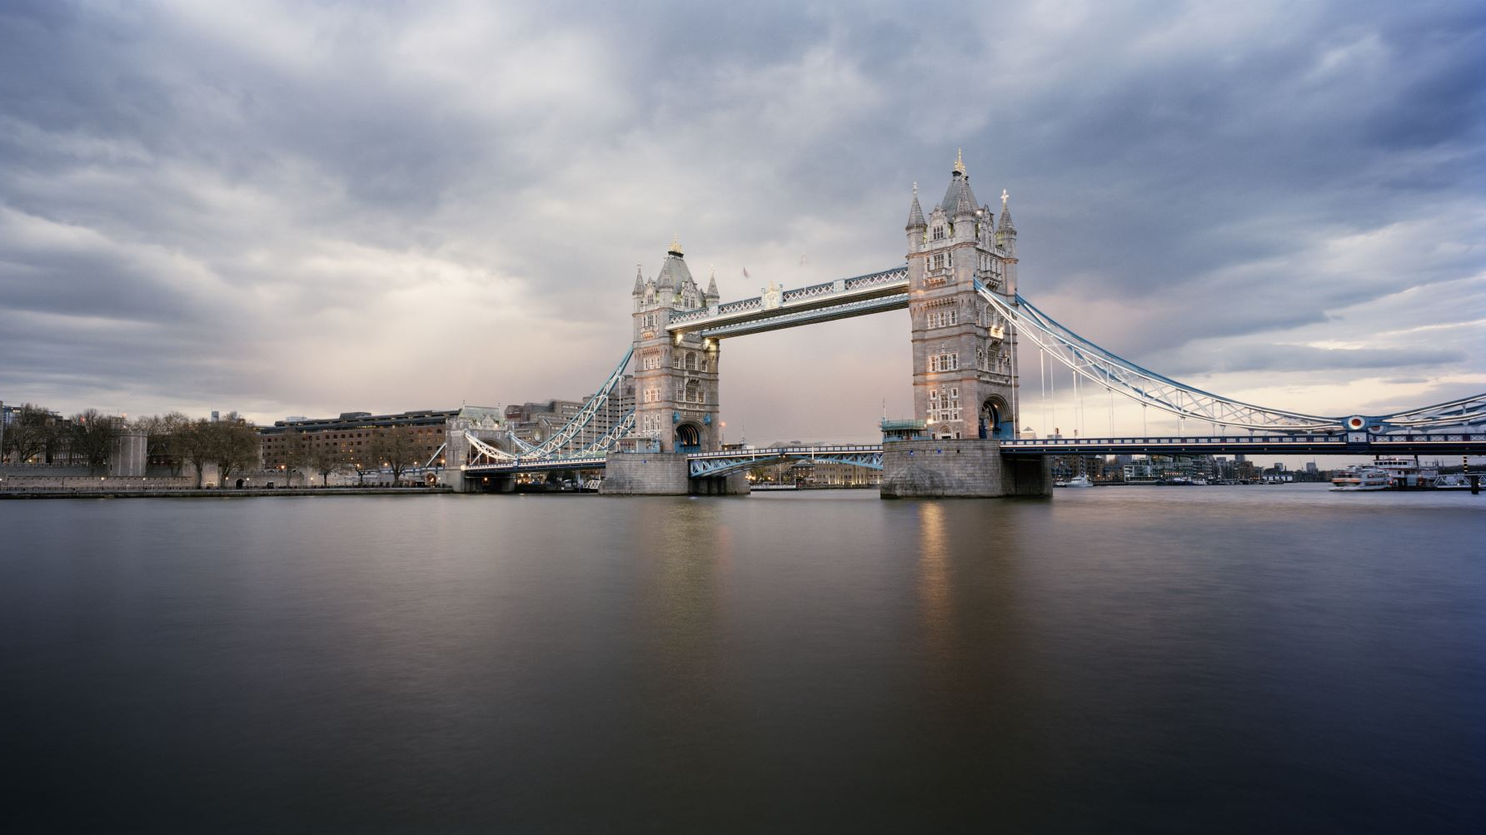
London Housing Project

Slide 2
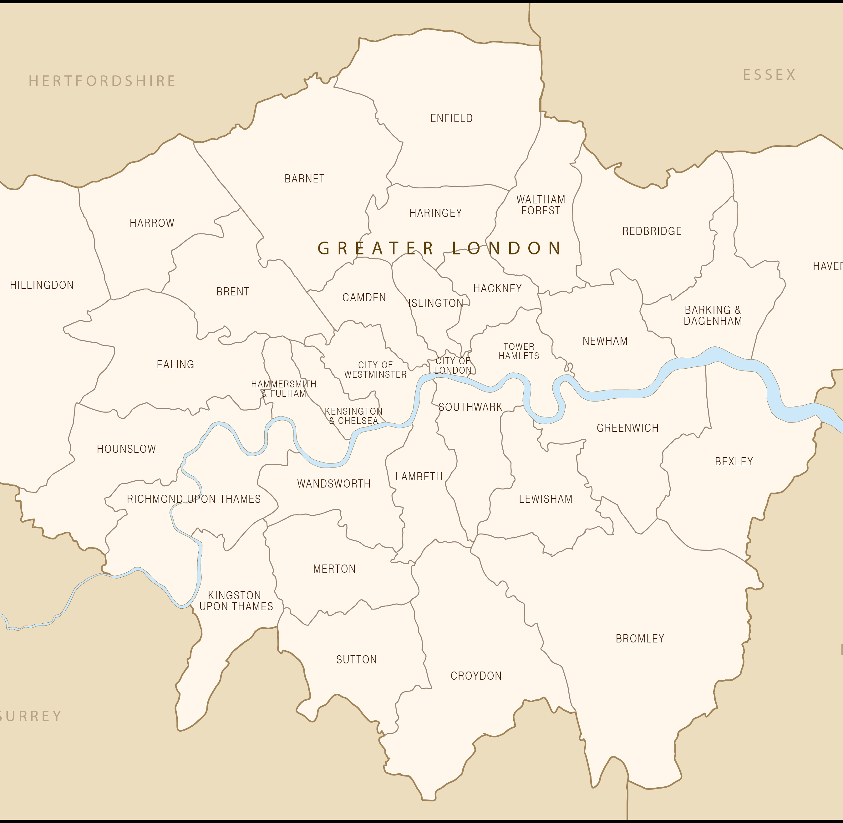
Problem Statement : Which boroughs of London have seen the greatest increase in housing prices, on average, over the last two decades?

Slide 3
A borough is a district and there are 32 boroughs within Greater London.Some of them are more desirable areas to live in, and the data will reflect that with a greater rise in housing prices.
Data Source - https://data.london.gov.uk/download/uk-house-price-index/70ac0766-8902-4eb5-aab5-01951aaed773/UK%20House%20price%20index.xls
The Excel file contains 49 Rows and 311 Columns.
The file contains data on boroughs, months , ID and average house prices.

Slide 4
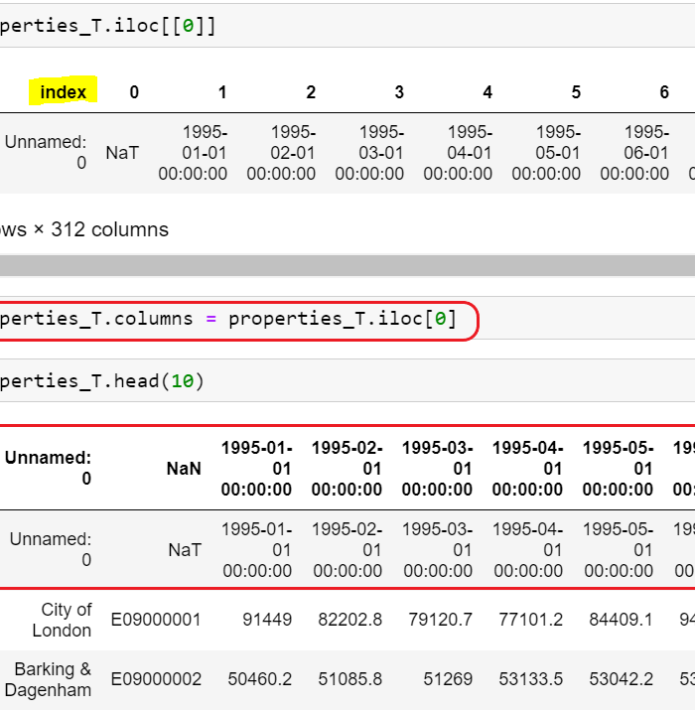
In the original dataframe the column names were Borough names, and the column names were months, which were transposed.The index was reset. Upon transposing the row indices became column indices. Using iloc method, the column indices were dropped. The duplicate row was dropped.

Slide 5
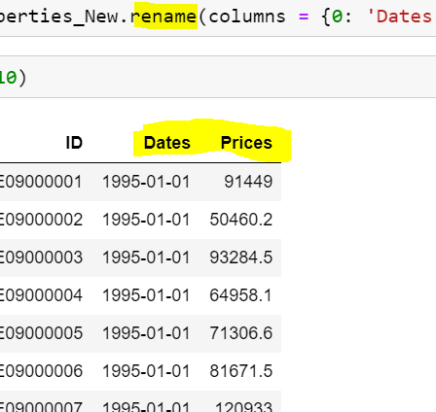
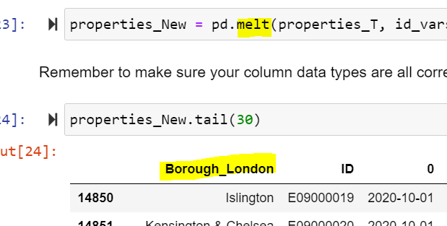
Unnamed: column was renamed to Borough_London and the dataframe was melted using panadas melt() from wide to long format to make it more clean.

Slide 6
Issues found and remedial actions.
The original dataframe contained some Non-Borough data along with null values(NaN-Not a Number).
There were 930 rows with ‘NaN’ value which were removed.
As there are only 32 Boroughs in London, any non-unique data was dropped as well.

Slide 7
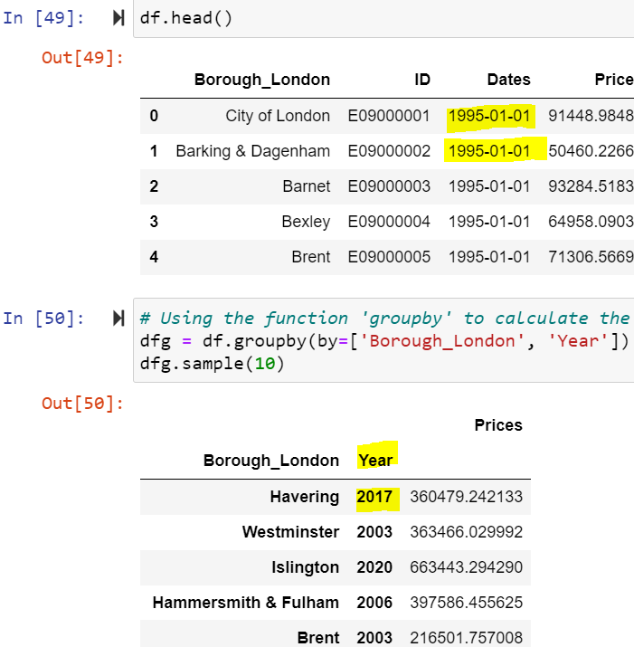
As the time frame was in months, it was consolidated (grouped) into years in order to make the new dataframe compact ,readable and easier to plot.

Slide 8
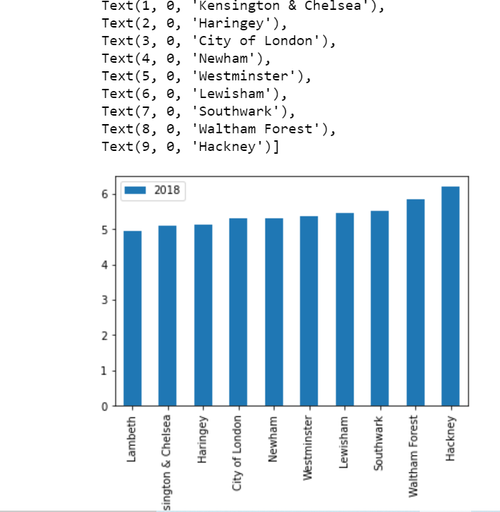
Hackney is the most expensive borough that has seen highest average price increase. Over a period of 20 years from 1998 to 2018 house prices in this borough have almost become 6.2 times the original price.

Slide 9
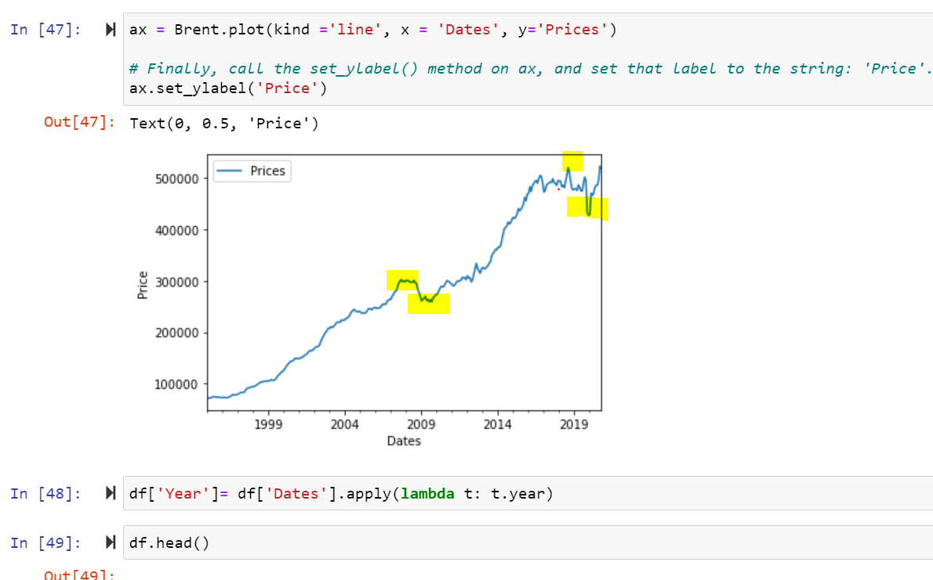
Where there any fluctuations like sudden spikes or dips between 1995 and 2020?

Slide 10
Thank You.

